Slide 1
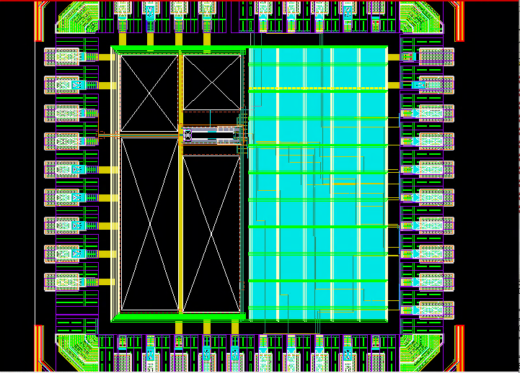
OD.DN.3
<Insert screenshot, from lvayout, of violation here>
De-cap cells block dummy OD fill.
Achieved Local Density: 3.7%
Achieved Local Density: 3.4%
DRC density: 20%
Exclusion regions near analog input routes block dummy OD fill.
Achieved Local Density: 1.3%
DRC density: 20%

Slide 2
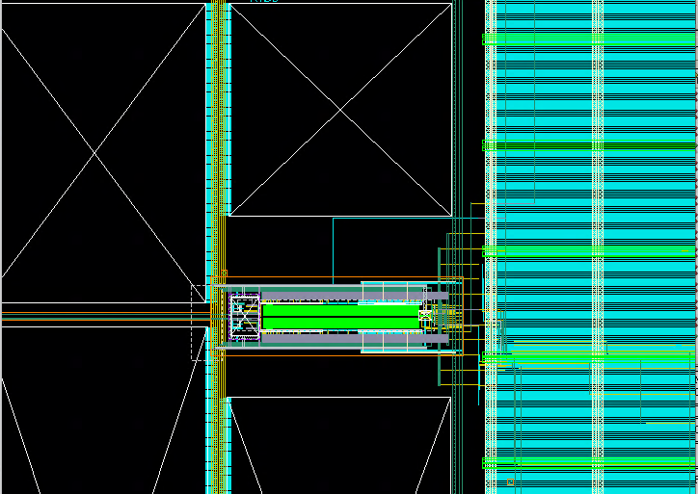
PO.DN.3
<Insert screenshot, from layout, of violation here>
Exclusion regions near analog core cell block dummy poly fill.
Achieved Local Density:4.03%
CapDAC in analog core lacks dummy poly fill.
Achieved Local Density:0.735%
DRC density:10%

Slide 3
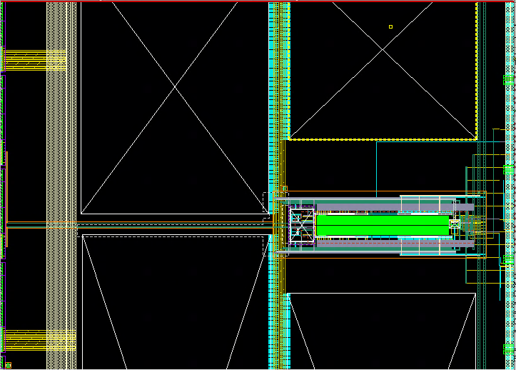
PO.DN.3.1
<Insert screenshot, from layout, of violation here>
Exclusion region near analog routes blocks poly dummy fill.
Achieved local density: 8.8%
Internal CapDAC region of analog core lacks dummy poly.
Achieved local density: 1.6%
DRC density: 10%

Slide 4
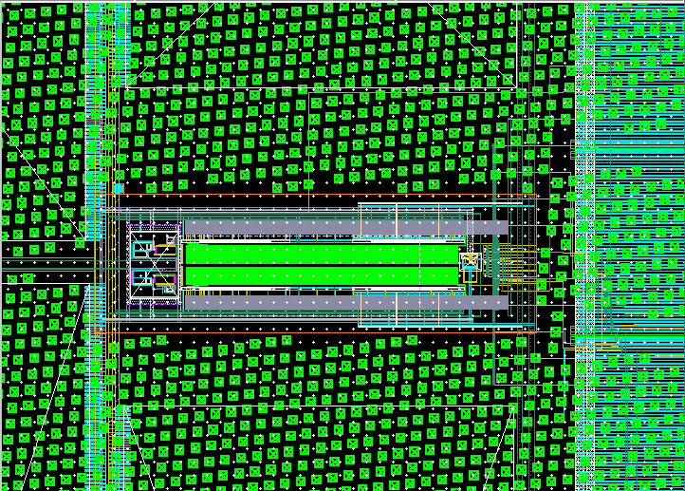
Mx.DN.7:M1_M2_M3
<Insert screenshot, from layout, of violation here>
Internal CapDAC region in analog core lacks M1-M3.
Achieved local density (M1): 2.98%
Achieved local density (M2): 1.09%
Achieved local density (M3): 3.9%
DRC density (M1-M3): 5%

Slide 5
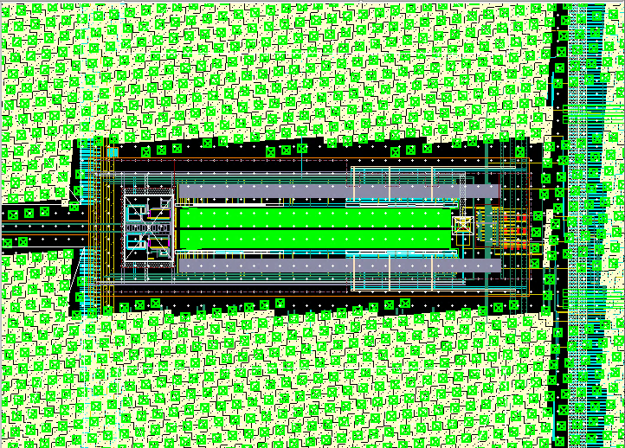
M6.DN.6
Analog core cell uses little M6 routing.
Achieved density: 0.74%
DRC density: 1%

Slide 6
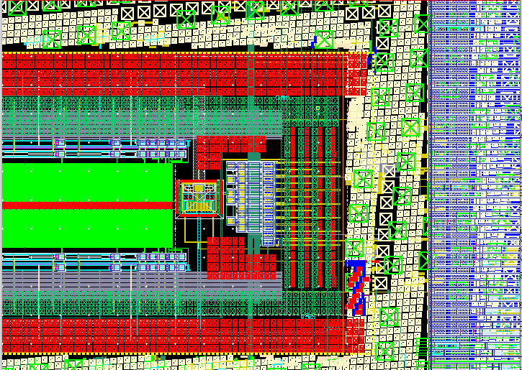
Mx.DN.7:M5_M6_M7
<Insert screenshot, from layout, of violation here>
Analog core cell region lacks M5-M7 routes.
Achieved density (M5): 2.68%
Achieved density (M6):0.9%
Achieved density (M7):0.1%
DRC density: 5%

Slide 7
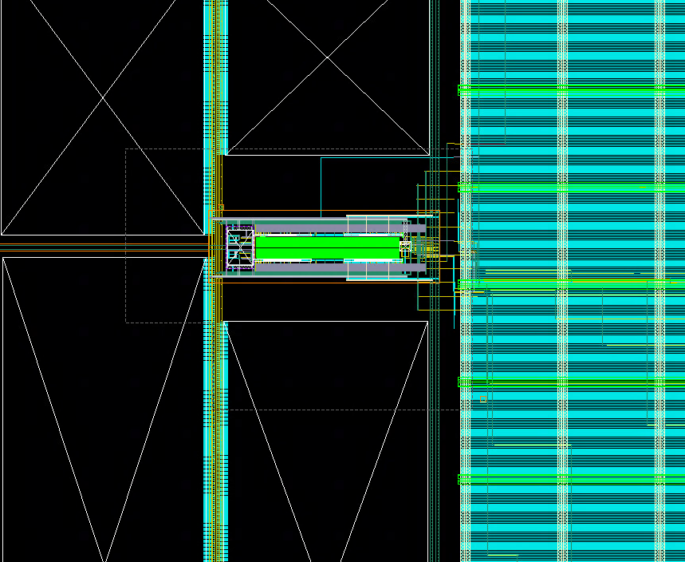
M9.DN.3
Analog core use little M9 routes.
Achieved density: 0.4%
DRC density: 20%
<Insert screenshot, from layout, of violation here>

Slide 8
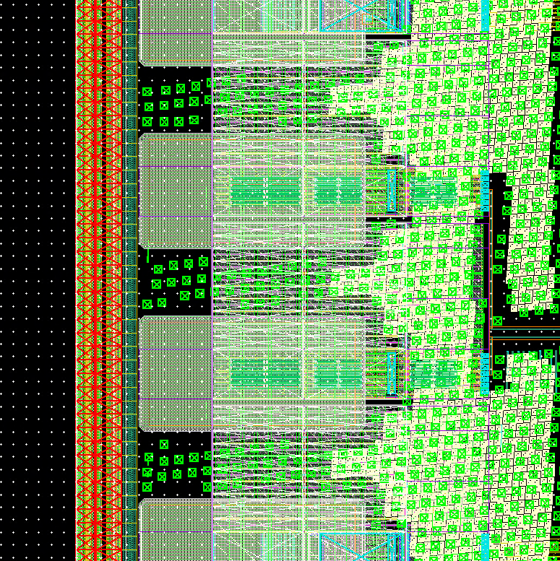
ESD.WARN.1
<Insert screenshot, from layout, of violation here>
No Secondary ESD protection is included

